Slide 1
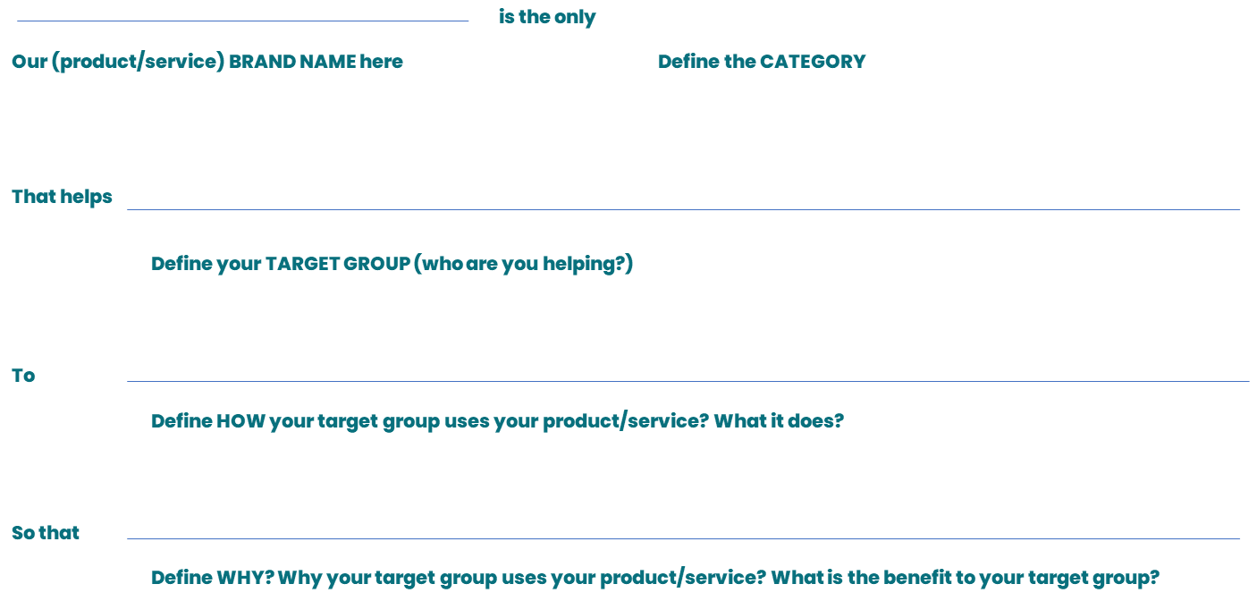
Brand promise canvas
GROW PHASE
This work is licensed under CC BY-SA 4.0. To view a copy of this license, visit http://creativecommons.org/licenses/by-sa/4.0/

Slide 2
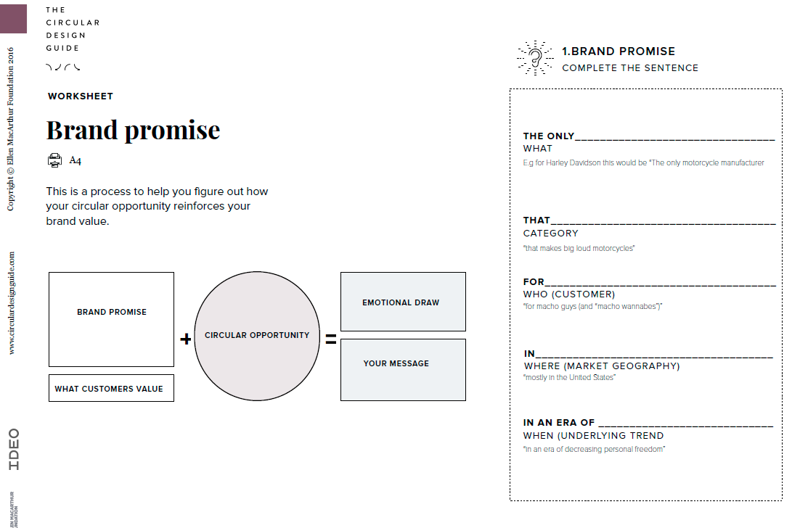
Brand promise canvas example from Circular design guide
GROW PHASE
This work is licensed under CC BY-SA 4.0. To view a copy of this license, visit http://creativecommons.org/licenses/by-sa/4.0/

